Slide 1
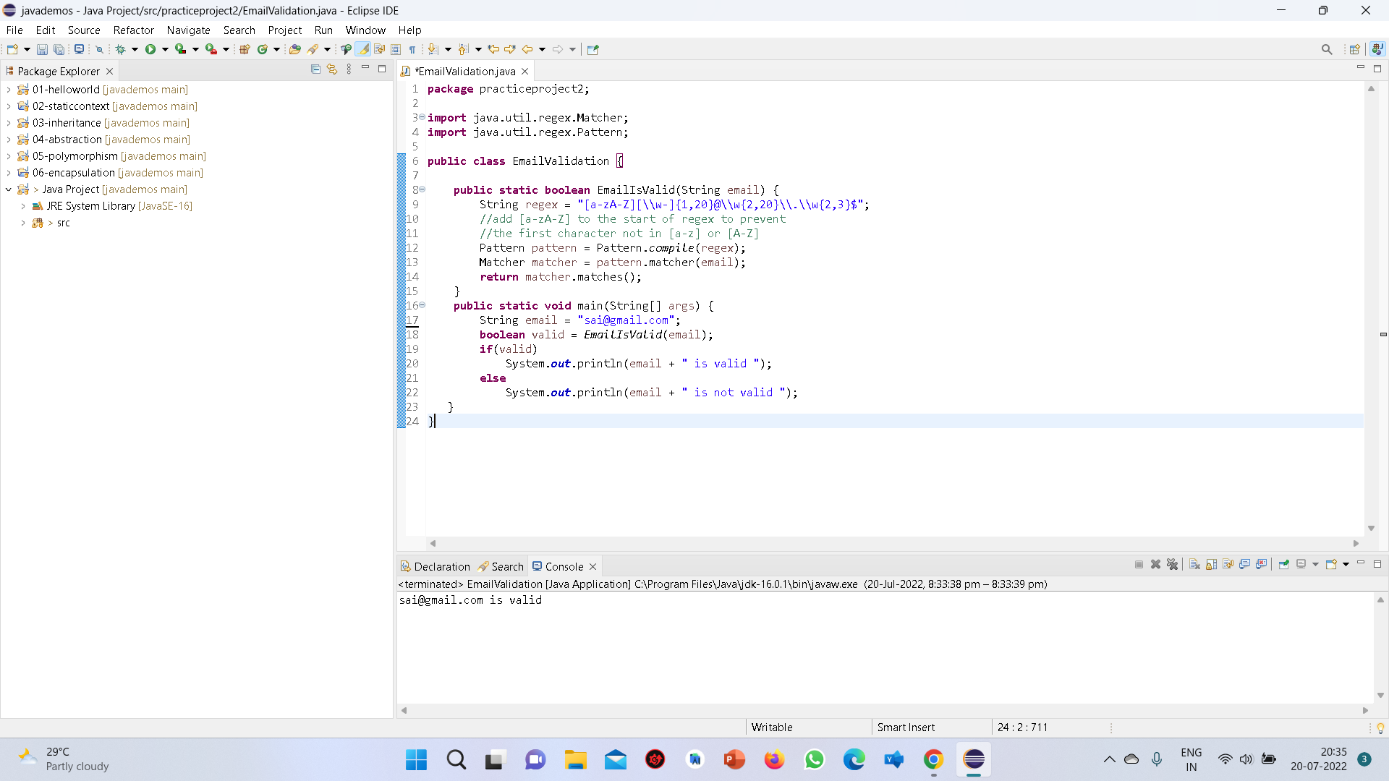
EMAIL VALIDATION

Slide 2


